Slide 1
Student-Centered Growth System

Slide 3
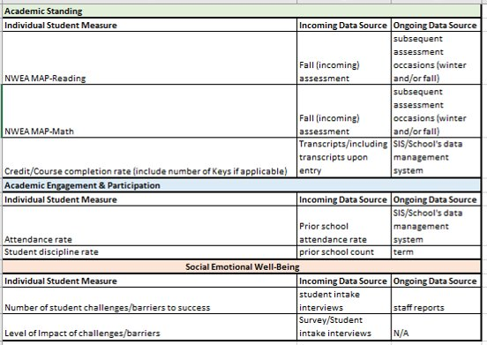
Stage 1 Schools select school-based measures that fit in each domain

Slide 4
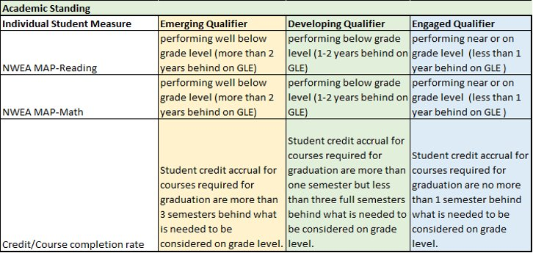
Stage 2 Establish number of cut points Example below includes three levels. Cut points are established based on research and/or internal school data

Slide 5
Stage 3 Score each student on the index
Student Engagement Phase | General Description
Engaged | Little support is needed, student can focus on schoolwork for large chunks of time, and student is close to or at grade level.
Emerging | Substantial supports needed and student’s focus in an educational setting or on assignments is minimal, and the student is behind grade level.
Disengaged | High needs but never attends, will not respond to calls/visits, no caregiver can be reached.

Slide 6
Stage 3 Score each student on the index
Academic Standing
Individual student measure | Emerging Qualifier | Developing Qualifier | Engaged Qualifier
Local reading assessment​ | 1.5 or more GLE behind​ | 0.8-1.4 GLE behind​ | 0.7 or fewer GLE behind​
Local math assessment​ | 1.5 or more GLE behind​ | 0.8-1.4 GLE behind​ | 0.7 or fewer GLE behind​
Credit accumulation​ | More than 3 semesters behind what is needed to be considered on grade level.​ | More than one semester but less than three full semesters behind what is needed to be considered on grade level.​ | No more than 1 semester behind what is needed to be considered on grade level.​
Academic Engagement and Participation
Individual student measure | Emerging Qualifier | Developing Qualifier | Engaged Qualifier
Behavior incidents count​ | 3 or more incidents per semester​ | No more than 2 incidents per semester​ | 0 behavior incidents per semester​
Self-management scale ​ | Score b/t 8-12​ | Score b/t 13-20​ | Score 21 or higher​
Social-Emotional Well-Being
Individual student measure | Emerging Qualifier | Developing Qualifier | Engaged Qualifier
ACES Score​ | 3+​ | 1-2​ | 0​
Self-Efficacy​ | Score b/t 5-7​ | Score b/t 8-10​ | Score 11 or higher​
Emotion Regulation​ | Score b/t 8-12​ | Score b/t 13-20​ | Score 21 or higher​

Slide 7
Stage 4 Set goals for continuous improvement and progress monitoring
Student Engagement Phase | Description | Goal
Engaged | Some support needed, close to grade level​ | Earn 6 credits per year​
Emerging | Substantial need, attending school, behind academically​ | Earn at least 4 credits in core courses and attend counseling and engagement strategies in school and/or work/internship outside of school​
Disengaged | High need, chronically absent, disengaged​ | Earn at least 1 credit in a semester and attend daily counseling, wrap around services, engagement strategies, or internship/work.​

Slide 8
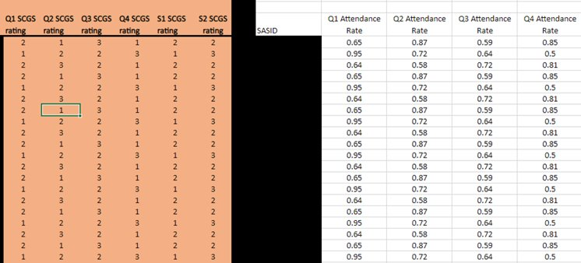
SCGS Calculator – Sample of Individual Measure Data Collection

Slide 9
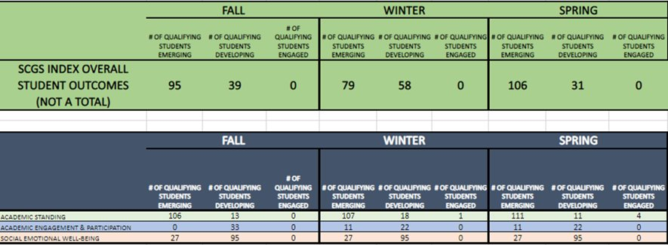
SCGS Calculator – Sample of Overall Index Reporting

Slide 10
Stage 5 Set goals for accountability purposes
Typical accountability goals assume most students are on track, progress at the same pace and have little or no social-emotional needs, AND that those who aren’t the same are simply expected to not meet the goal. For example:​
At least 75% of students will earn a minimum of 6 high school credits each year ​
(assuming 24 credits are need to graduate)
Phase | Revised Accountability Goals
Engaged​ | At least 95% of engaged students will earn six or more high school credits in one academic year (typical goal, higher percentage to meet)​
Emerging​ | At least 95%, of emerging students will earn at least four high school credits in one academic year (inclusive of summer school).​ (fewer credits, same timeframe)​
Disengaged​ | At least 95% of disengaged students will earn one credit in one semester. ​ (fewer credits, shorter timeframe)​

Slide 11
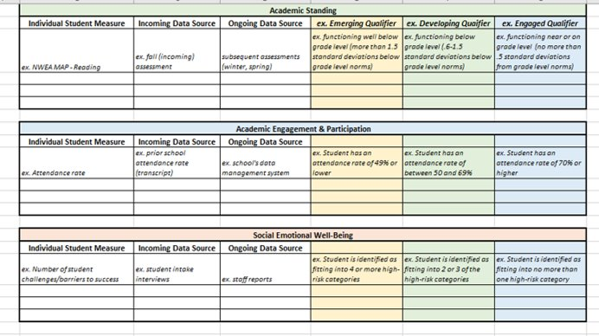
What would your school’s SCGS look like?

Slide 12
Interested in learning more…
Visit: https://www.reengagingstudents.org/
Contact: Jody Ernst, jernst@momentum-sr.org
or Kelly Chrisman, kchrisman@momentum-sr.org

